Slide 1

Washington at Work: The Impact of Tax and Healthcare Reform on Law Firms
Presented by:
Russ Sullivan, Partner
McGuireWoods LLP
rsullivan@mcguirewoods.com
August 9, 2017

Slide 2
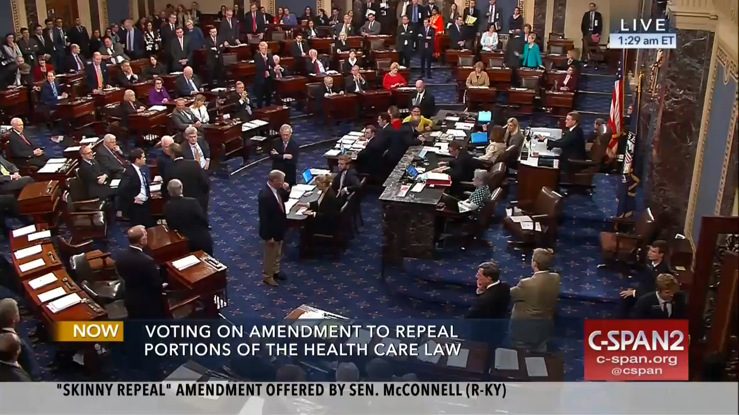
Senate Healthcare Vote
Source: video-cdn.buzzfeed.com

Slide 3
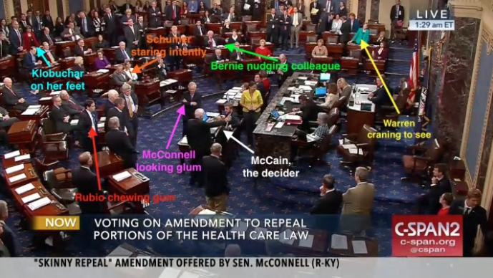
Senate Healthcare Vote
Source: C-SPAN and Buzzfeed

Slide 4

What is Going on in Washington DC?
With the collapse of the ACA repeal and replace effort in the Senate, the debate over comprehensive healthcare reform ends for this year.
But we expect that some proposals on healthcare fixes will become law:
  Regulatory action
  Market stabilization legislation
  Must-pass legislation

Slide 5
Trump Administration is Marching Forward
HHS Secretary Price has charged his team to review all of the ACA regulations. At the rate of 10 sets of regulations per week, it will take 18 months to review these regulations.
The Administration will need to decide whether to continue the cost-sharing payments for low-income participants, to help them with deductibles and co-pays. These payments have been made on a month-to-month basis since January. A group of 16 Democrat Attorneys General has successfully intervened in the lawsuit which will complicate the Administration’s ability to unilaterally end these payments.

Slide 6
Prospects for Some Healthcare Legislation to Pass This Year is Good
The ACA repeal and replace effort was moving under special reconciliation rules in the Senate so that it only required 51 votes to pass. There are 52 Republican Senators.
There are Democrat Senators who know that the ACA needs some fixes but they were not willing to be associated with the Republican effort to “repeal.”
Following the collapse of the ACA repeal and replace effort, Senate HELP Committee Chairman Alexander (R-TN) announced regular order hearings on healthcare reform starting the first week in September.

Slide 7

House Problem Solvers Caucus
A group of 43 moderate Republican and Democrat House members who came together to work on tax and infrastructure last Congress have released a list of 5 recommendations to stabilize the individual health insurance marketplace:
  Permanently continue the cost-sharing reduction payments
  Create a stability fund that states can use to help with high cost individuals
  Adjust the employer mandate to begin for businesses of 500 or more employees
  Repeal the Medical Device Tax
  Allow streamlined Section 1332 waivers for the states
Source: https://thoughtcatalog.files.wordpress.com

Slide 8

What Each Side Likes
Republicans
Scale up of the employer mandate to 500 employees.
Flexible state waivers
Repeal of the Medical Device Tax
Democrats
Certainty about the cost-sharing payments
Reinsurance/State stability funds
Assistance for low income individuals in the 19 states where Medicaid was not expanded

Slide 9
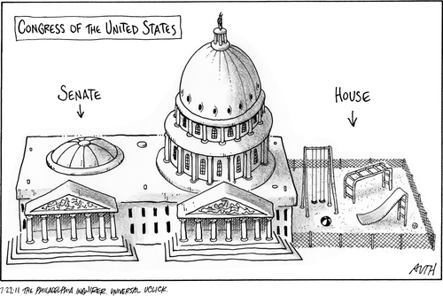
Must-Pass Legislation
By the end of September, there are three pieces of legislation that must pass the Senate with at least 60 votes. This will require bipartisan cooperation.
  Debt Limit
  Appropriations bills or a Continuing Resolution (“CR”)
  Reauthorization of CHIP
Some of these could be combined into a larger bill.

Slide 10

So What Happens?
Market stabilization items get added to some vehicle moving in the Senate. It will likely be similar to the Problem Solver Caucus ideas.
Tax items get added to a tax vehicle moving at the end of the year.

Slide 11
Why Does This Matter to You?
The individual market stabilization is not aimed at the large employer group market where law firms purchase healthcare benefits.
When the individual marketplace is functioning well, there is less pressure on your large employer group market.
In fact, after the ACA passed, major insurers negotiated lower rates with hospitals and providers when they thought they were getting a large influx of new insureds.
Individual rates are in fact lower than the rates that large self-insured groups are paying.

Slide 12

New Insurance Models?
Some companies are beginning to market to employer group plans 500-5,000 where the policies populating the group health plan are individual policies, selected by employees.
These new options could be on the horizon for many of us in the future.

Slide 13

Tax Reform – Where We Stand in the Fall
With the ACA repeal and replace effort moving into the background, Congress will focus its attention on tax reform.
Tax Reform
  Why it is so important
  Why it is likely to succeed
  What you will be hearing in the fall
  Impact on law firms and employees

Slide 14

The Republican Takeover Promised an Economic Jolt
Republican candidates said 2% sluggish growth is not enough.
Trump promised new and better jobs for the coal miners and heartland workers that Obama had “left behind.”
Campaign proposals included infrastructure investment, tax reform, trade renegotiation, regulatory reform, and an immigration overhaul.

Slide 15
Why Is Economic Growth So Important?
A majority of voters tend to forgive other problems in the nation if their economic fortunes are improving.
Incumbents are most likely to lose their seats if the economy is not growing.
Incumbents get re-elected by wide margins when the economy is growing at better than 3%.
There are exceptions to the rule (George W. Bush in 2004).

Slide 16
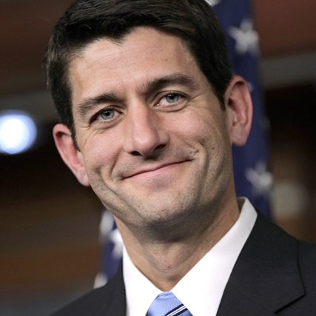
Why Tax Reform Is So Important for the GOP
Tax reform is the main contribution Congress can make to encourage economic growth.
Other initiatives hold limited potential for economic growth
  Healthcare
  Immigration
  Trade Reform
  Infrastructure
  Regulatory Reform
“We are going to be delivering tax reform in the fall […] Every Republican I know in Congress is dedicated to getting tax reform done. We realize this is existential for the future growth of our economy and the competitiveness of American businesses, big and small.”
- House Speaker Paul Ryan

Slide 17

Immigration Reform Has Limited Upside Potential for Growth
The fewer immigrants that come to the U.S., the better chance for American to have more choices in jobs.
Not all employers see it that way.
  Many owners are loyal to workers from overseas.
  Some will move the business abroad.
Fewer immigrants also depress demand for goods and services.
While the politics are loud, change is happening slowly.

Slide 18

Trade Renegotiation: Slow Progress
Trump promised better trade agreements than what Bush and Obama negotiated.
Trump withdrew the US from the Pacific Trade Partnership.
NAFTA will be renegotiated this fall.
No other significant trade negotiations are currently scheduled.
Most trade experts doubt these actions will spur economic growth.

Slide 19

Infrastructure Holds Promise For 2018
Both Trump and Congressional Democrats have called for $1 trillion in new infrastructure.
Democrats want public funding of a wide assortment of infrastructure.
Trump also wants a variety, but funded by public-private partnerships through an investment tax credit.
Neither side has moved to negotiate or pass an initiative. No comprehensive bill has been introduced.
Congressional Republicans are uneasy about the project.
Bottom Line: Little will happen in 2017.

Slide 20
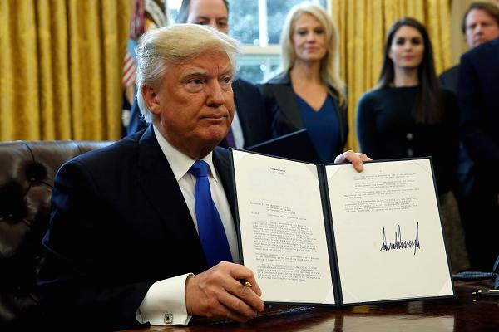
Regulatory Reform Has Begun
Trump and Republicans accused the Obama Administration of overreaching -changing the law by executive order, regulations and other guidance.
Trump sees the Washington regulatory regime as inhibiting investment by entrepreneurs and expansion by existing businesses.
Trump has taken action to rewind much of the Obama-era guidance.
Trump staff is reviewing a wide array of regulations in an attempt to determine which ones can be modified or reversed in a way to help commerce.

Slide 21
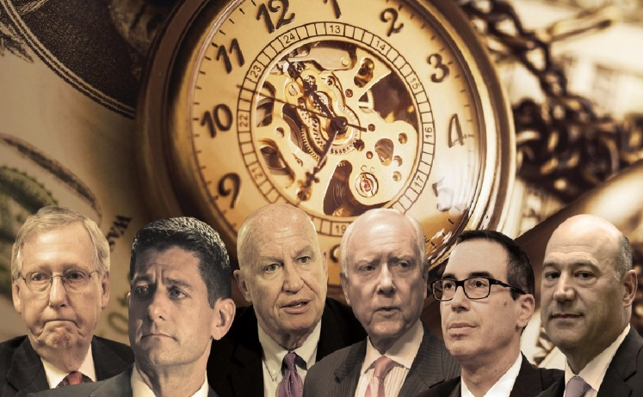
GOP Leaders Are Unified…
Before August recess, the “Big Six” issued a joint statement on tax reform. Key takeaways:
  Make taxes simpler and fairer
  Reduce tax rates as much as possible
  Place a priority on permanence
  Set aside the border adjustment tax policy
The Big Six have not reached an agreement on all aspects of tax reform – key questions on issues such as revenue neutrality and interest deductibility linger.
Source: http://cdn.washingtonexaminer.biz/

Slide 22

…But Lack Consensus
Procedure
  Revenue-neutral or increase the deficit?
  Budget reconciliation process or regular order?
Substance
  What is the target tax rates?
  Disallow net interest expense deductibility?
  Permit full and immediate capital expensing?
  Modify retirement savings rules?
The statement signals that the GOP is moving away from the House GOP Tax Blueprint, and looking at other tax reform ideas.

Slide 23
Potential Impact on Law Firms
Dramatic proposals in retirement savings.
Student loan debt reduction on par with retirement savings and healthcare.
Decoupling individual tax rates from pass-through entity tax rates.
Force law firms to go from cash method of accounting to accrual method of accounting.

Slide 24
Tax Reform - Pensions
“Half Roth”– Camp Tax Proposal
  All elective deferrals into qualified retirement plans above $8,750 would be made after tax.
  Employers with more than 100 employees must amend their plan documents to allow employees to make Roth contributions.
“Full Roth”
  The most ambitious retirement reform would limit the current system of tax-deferred saving in 401(k) and traditional IRA accounts, shifting the emphasis to Roth accounts.
House Tax Reform Blueprint
  Continue the current tax incentives for savings but with consolidated retirement savings provisions to provide effective and efficient incentives for savings and investment. Possibly Universal Savings Accounts.

Slide 25

Tax Reform – Student Debt Reduction
In 2017 the national student debt surpassed $1.3 trillion; the average 2016 class graduate owed $37,000.
Nearly 79 percent of Americans have access to a employment-based retirement savings account, but few Americans are able to make the maximum contribution ($18,000) to their account.
Solutions:
  Allow employees to utilize a percentage of their unused 401(k) exclusion to pay down student debt.
  Allow employers to allocate 50% of their employer match to the employee’s retirement savings account and the remaining 50% to pay down the employee’s student loans. Employees could also opt to have 100% to go to the retirement savings account as an employer match.

Slide 26

Tax Reform - Decoupling Individual and Business Income
Both the House GOP Tax Blueprint and the Camp tax reform draft contemplate reducing tax rates for small businesses (read: pass-through entities) so they can compete with larger ones.
If there is a substantial disparity between the pass-through and the individual income tax rate, individual taxpayers (partners) will seek ways to subject their income to the pass-through rate.
Depending on accompanying anti-abuse rules, law firms may face pressure from employees to modify their current employment policies.

Slide 27
Tax Reform - Changes to Methods of Accounting
The Camp tax reform draft requires large law firms (over $10 million in revenue) to use the accrual accounting method; cash accounting method is not allowed.
Any positive adjustments as a result of transition to the accrual accounting method, would be included in income over a four-year period.
Law firms financials could be greatly impacted (e.g., pay tax on “phantom income”, restrict client fee flexibility).

Slide 28
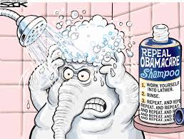
Questions or Comments?
Russ Sullivan
Partner
rsullivan@mcguirewoods.com

