Slide 1
Leadership: Your Competitive Advantage

Slide 2
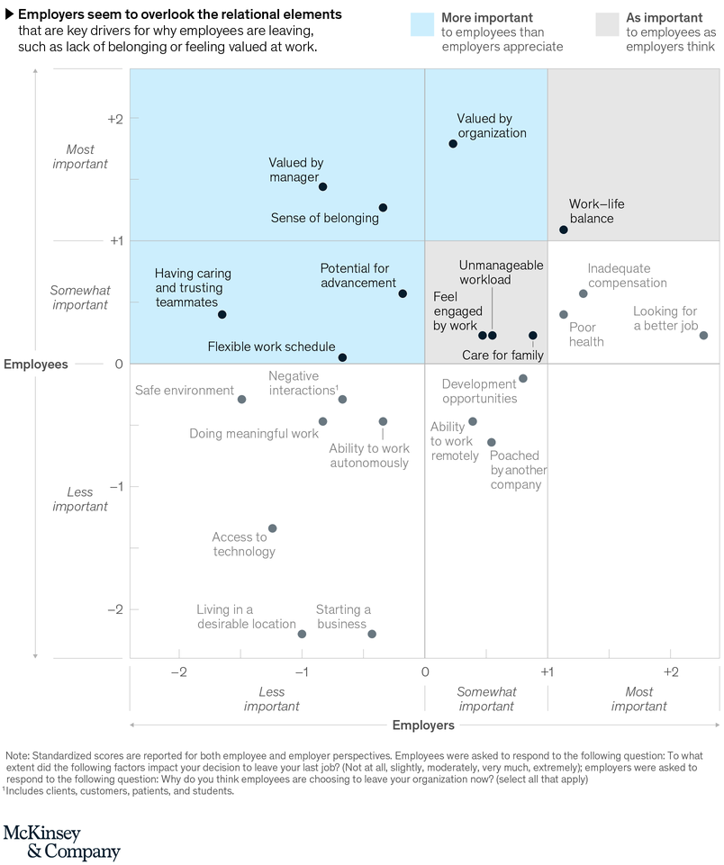

Slide 3
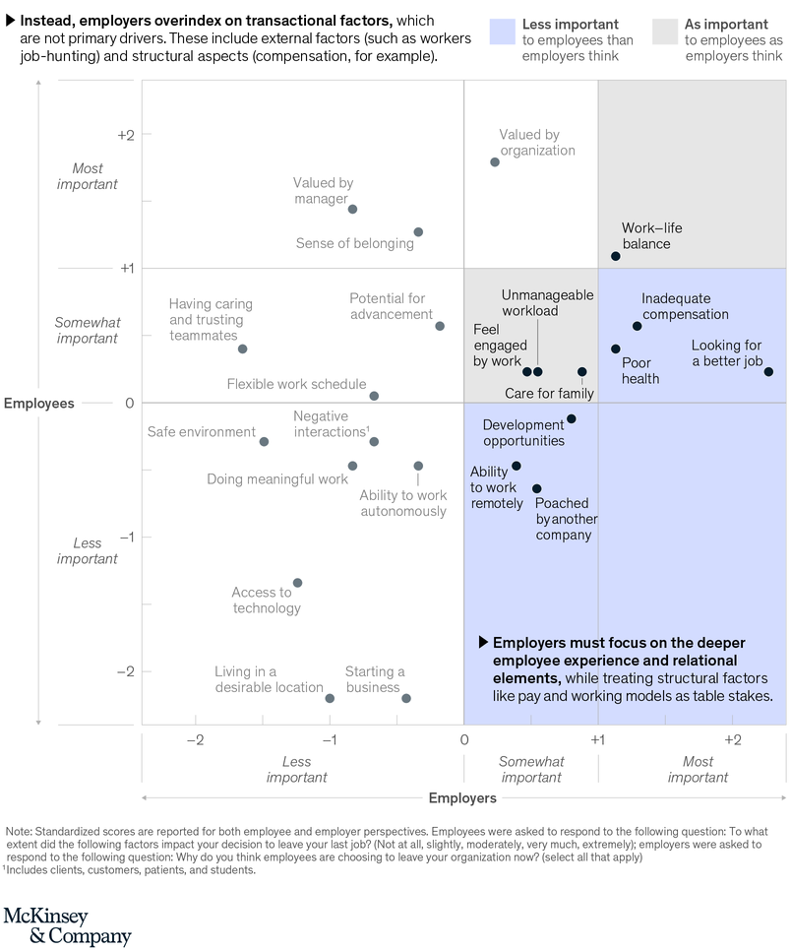

Slide 4
Culture
Empathy
Vulnerability
Connection
Contribution
Credibility

Slide 5
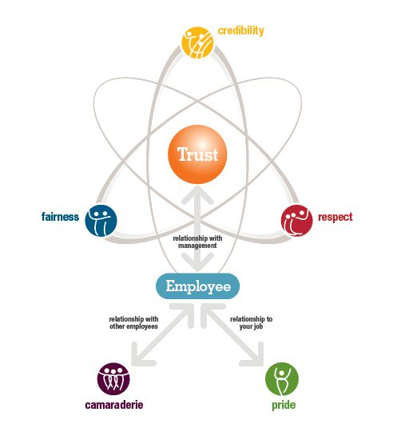
Great Place to Work©

Slide 6
Elevating Engagement
Social | Work | Organization
People and Relationships Treated as a contributor | Organization Resources & responsibilities Interesting work | Purpose Contribution Values alignment
Teamwork Collaboration Trust | Control and flexibility Positive integration | Technology - Ease and efficiency
Social climate Sense of belonging | Growth and rewards Incentives and growth Compensation | Physical environment Human centered Safe and comfortable
McKinsey & Company, Shaping the new possible

Slide 7
Care
Nutrition
Sleep
Exercise
Mindfulness
Gratitude
Play

Slide 8

Contagious

Slide 9
Reflection Questions
How will this make me better?
How will I use this to help other people?
What action will I take to improve my situation?

Slide 10
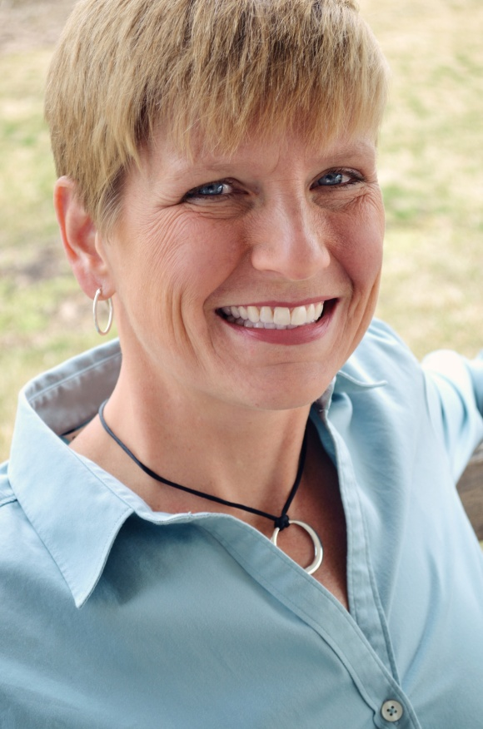




About the Speaker
Judy Hissong is the President and founder of Nesso Strategies. With over 15 years experience inside professional service organizations, she brings a wealth of knowledge and expertise in leadership, Emotional Intelligence, and strategic planning. A lifelong learner, professional coach, and athlete she partners with law firms to maximize performance – in strategic planning, leadership growth and team development.
619.546.7885
www.linkedin.com/in/judyhissong/
Judy@NessoStrategies.com
@judyhissong

